Slide 1
The Euclid Mission – accuracy and precision
Mark Cropper (MSSL-UCL), Tom Kitching (MSSL-UCL),
Henk Hoekstra (Leiden), Will Percival (U-Portsmouth)

Slide 2
Precision and Accuracy
As precision increases ⇔ confidence intervals tighten
Eventually the confidence interval may not enclose the “true” value if there are systematic biases – inaccuracies – in the measurement
effect of increasing measurement
precision (eg from a larger sample size)
parameter 2
“true” value
(from a perfect measurement)
bias in
parameter 2
bias in parameter 1
parameter 1

Slide 3
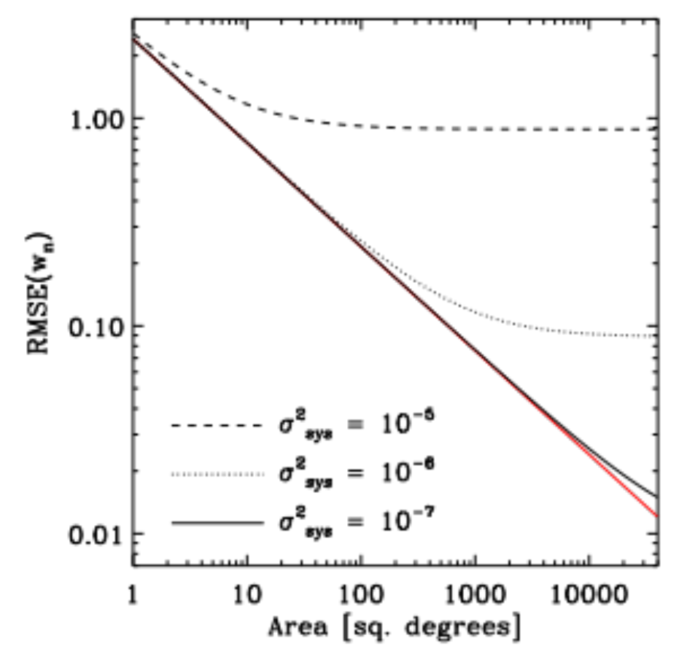
Precision and Accuracy
Massive surveys such as the Euclid survey are designed massive so as to tighten the precision in the measured parameters…
To meet the required level of
precision, Euclid needs
  1.5x10⁹ galaxies for weak lensing
  3x10⁷ galaxies for galaxy
  clustering
Once precision increases to such
levels, systematic biases become
increasingly evident
Euclid requires both
  sufficient precision, and
  sufficient accuracy
  i.e. control of systematic bias
with systematic biases
Total error in a dark energy equation of state
no systematic
biases
Amara & Refregier (2008)

Slide 4
Euclid survey: achieving the precision
To achieve the precision via a sufficient number of sources
(WL and GC), various trades are required in terms of survey volume (area and depth)…
To have a mission at all:
  constraints for an M-class mission
  (payload mass hence primary mirror size; cost; technology readiness level, mission duration etc.)
  sample distribution
  (magnitude range hence S/N ratio, redshift; galaxy size etc.)
  selection as a mission
  (meeting performance sufficient to advance the science significantly; acceptable risk; credibility at all levels)
In Euclid a suitable and feasible concept was achieved
  1.2m mirror is enough to provide sufficient survey depth
  6 year survey is enough to provide sufficient area
  36 CCD focal plane (optical) + 16 HgCdTe focal plane (IR) are feasible
  K-band telemetry recently available to telemeter all of the data

Slide 5
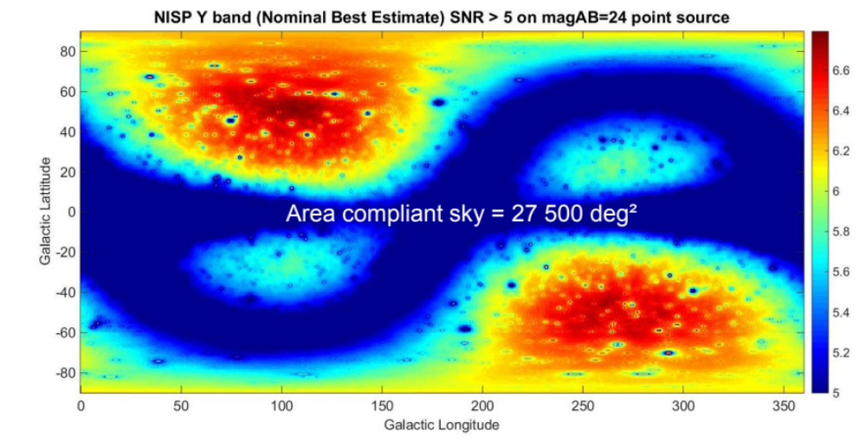
S/N ratio: example NISP Y Band
Amiaux
(Lausanne ESM15)

Slide 6
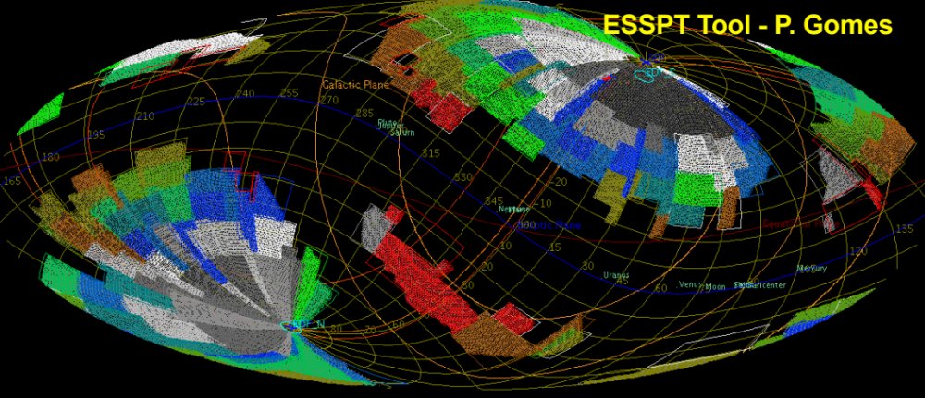
Euclid Survey: achieving the precision
Scaramella
(Lausanne ESM15)
15000 sq deg survey in 6 years with margin (~0.5 sq deg Field of View)
30 galaxies/sq arcmin in optical imaging
(R+I+z to magAB=24.5 @10σ; 0.1 arcsec sampling; 0.18 arcsec spatial resolution)
30 galaxies/sq arcmin in infra-red photometry
(Y, J, H to magAB=24.0 @5σ; 0.3 arcsec sampling)
3 galaxies/sq arcmin in infra-red spectroscopy
(1250-1850 nm to flux limit = 2x10⁻¹⁶ erg/cm²/s @3.5σ; Δλ/λ~500)

Slide 7
Accuracy – accuracy in Euclid
Given sufficient precision, accuracy is achievable once the biases are understood and compensated
Biases occur as a consequence of
  astrophysical effects and
  instrumental effects
Instrumental effects all occur in the instrument reference frame, and can in principle be removed entirely by stacking images in the instrument frame, given sufficient stability and S/N ratio

Slide 8
Instrumental biases
Instrumental effects include:
  PSF from telescope (including scatter from contamination)
  jitter from telescope pointing system
  charge spreading in detector pixels
  detector noise and stability
  detector response uniformity (wavelength and position)
  radiation damage
  thermo-elastic effects (change in focal length etc.)
  distortion/displacements
  persistence effects
  non-linearities in detector and electronics
  ghosts (optical and electronic)
  parasitic heating from satellite
  electromagnetic interference (noise)
  etc.
Entire subject in its own right – not pursued further here…

Slide 9
Astrophysical accuracy in Euclid
Astrophysical biases generally require simulation of the Universe in order to assess their origins and level of impact
⇒ final Euclid performance is driven by the fidelity of the simulations
⇒ all Euclid performance is couched in terms of residuals between the truth and our best knowledge of the truth
⇒ precision exists in the simulation too, driving simulation scale.
As the simulation precision requirement increases, new issues become
apparent
  for the nature of the components of the simulation
  the potential number of simulations, and
  in their analysis
⇒ sometimes a complete change of strategy is required

Slide 10
Accurate Astrophysics
Astrophysical biases for Weak Lensing to be considered include:
  intrinsic alignments
  noise bias
  colour gradients in galaxies
  galaxy templates for correct SEDs
  bright stars and masking
  unresolved binary stars and PSF shapes
  faint background sources
  feedback effects in galaxy evolution
  unlensed distribution as f(z) and f(environment)
Astrophysical biases for Galaxy Clustering to be considered include:
  galaxy density variation from stellar occultation/confusion
  galaxy density variation from dust
  galaxy density variation from Zodiacal background
All this is currently active work within Euclid
Significant impact on:
  survey design
  external calibrations
  simulations

Slide 11
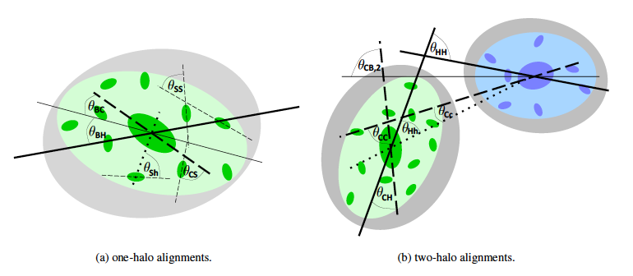
Intrinsic Alignments
Tendency for galaxies to align with local dark matter structures
Joachimi et al (2015)

Slide 12
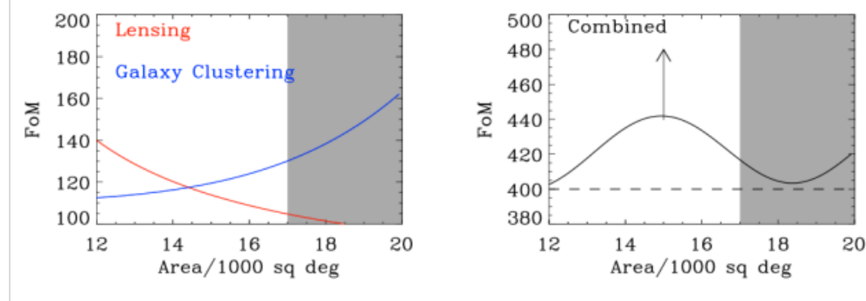
Survey Size: intrinsic alignments
Early analysis on the effect of the intrinsic alignments drove the survey size in the Euclid Red Book: deeper exposures at the expense of area identified to be more advantageous for weak lensing survey
⇒ sweet spot of 15000 sq degrees
but this needs to be revisited: currently active work
Euclid Red Book, Laureijs et al (2011)
Mission Performance Document EUCL-IAP-EUC-DP-00244 (2012)

Slide 13
Accuracy and Scale Dependence
At larger angular scales the cosmology depends on simple dark matter physics in the early Universe
On smaller scales of <1 Mpc and for z≤2 baryonic matter becomes dominant.
The small-scale power spectrum is very poorly understood beyond scales of k=1 h/Mpc: beyond this,
  the dark matter clustering is not well modeled
  (e.g. Lawrence et al., 2013);
  baryonic feedback processes are expected to dominate
  (e.g. van Daalen et al, 2011).
Although significant cosmological information is available on these scales, incorrect modelling of the astrophysics will cause biases

Slide 14
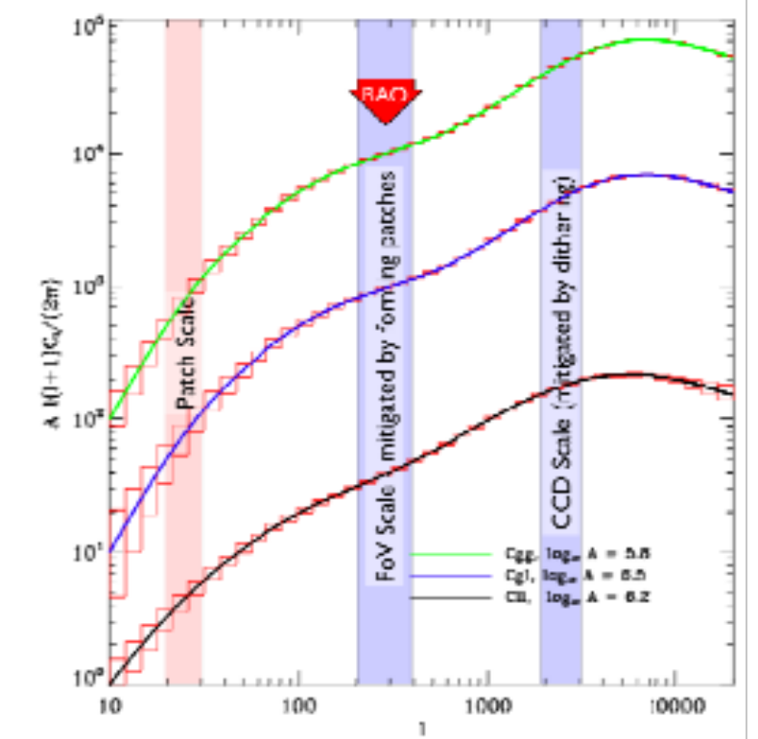
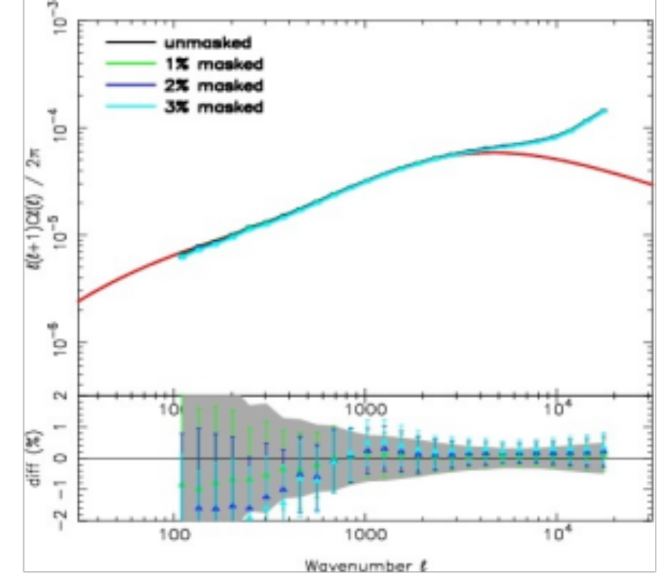
Baryon Physics in the WL Power Spectrum
Since 2011, a restricted range of scales is used for the Weak Lensing power spectrum to minimise the effects of baryonic feedback: l_{max}=5000, (Kitching & Taylor, 2011; Semboloni et al., 2011)
… led to more conservative performance assumptions
l < 20000
Amara & Carron in Amiaux et al (2010)
l < 5000
Euclid Red Book, Laureijs et al (2011)

Slide 15
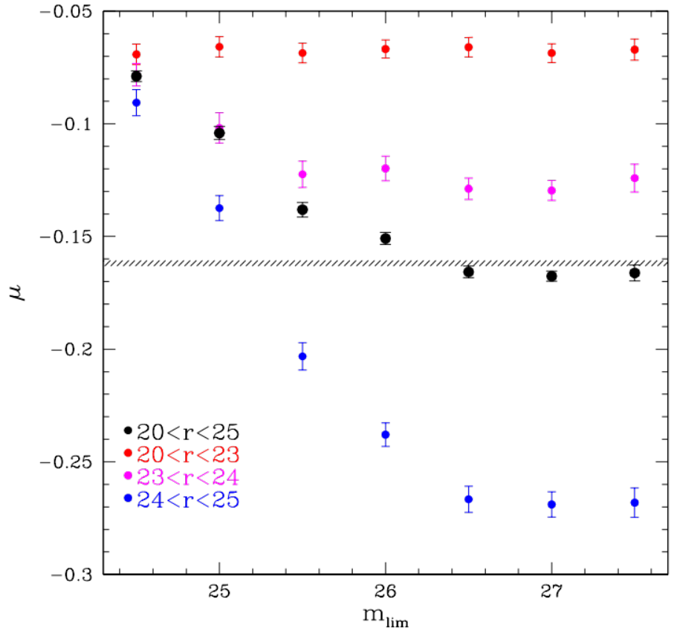
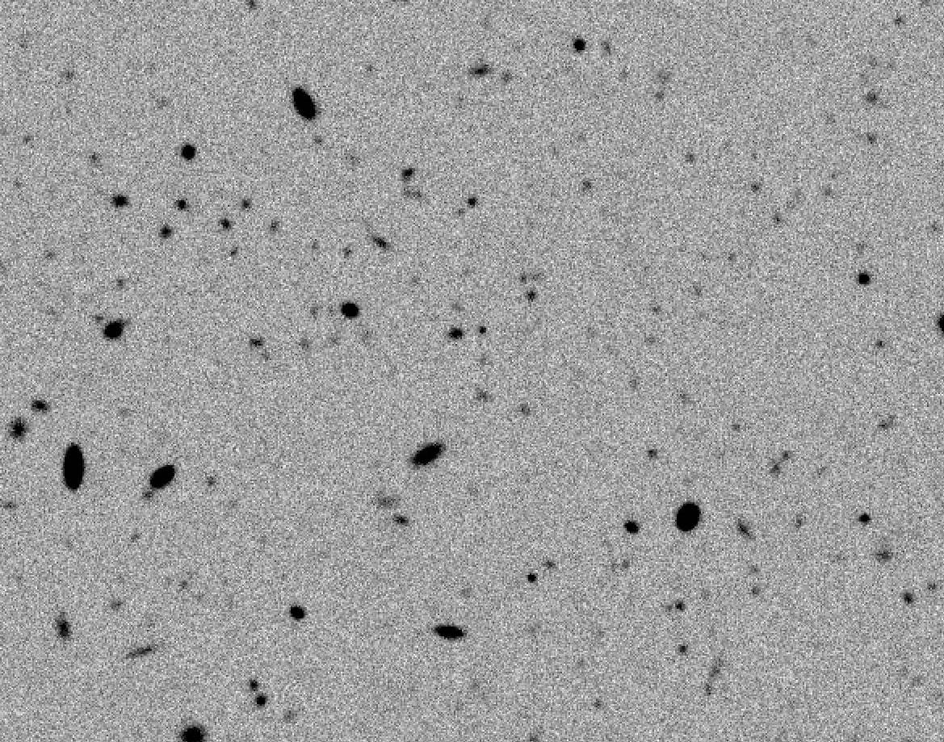
Backgrounds
VIS produces S/N ratio of ~1 at R~28 ⇒ a huge number of galaxies
Background subtraction is critical: VIS is not confusion limited but faint unresolved galaxies impact measured shapes of brighter S/N ≥10 galaxies (used for weak lensing), biasing ellipticities
Rlim=27
bias
Hoekstra et al (2015)

Slide 16
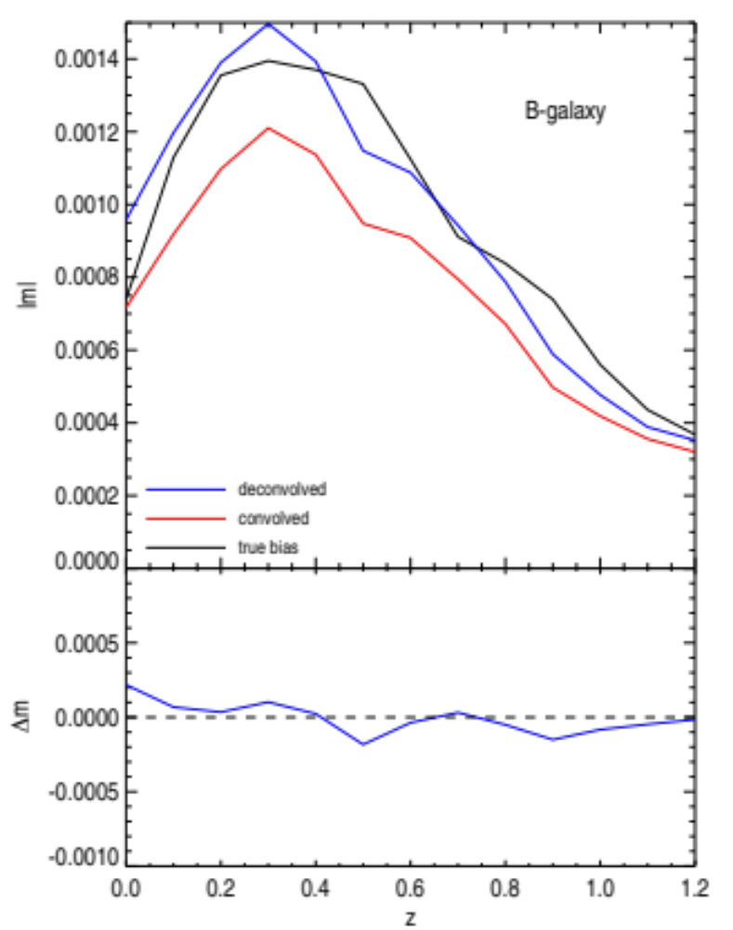
Colour Gradients in Weak Lensing
Galaxies are spatially colour-dependent e.g. they may have redder central regions compared to their outer regions
PSF is however constructed for a mean colour, so this introduces a bias
Early VIS versions carried filters in corner CCDs to generate colour samples for calibration
Calibration as f(z) now achieved by external (HST) sample
Semboloni et al (2013)

Slide 17
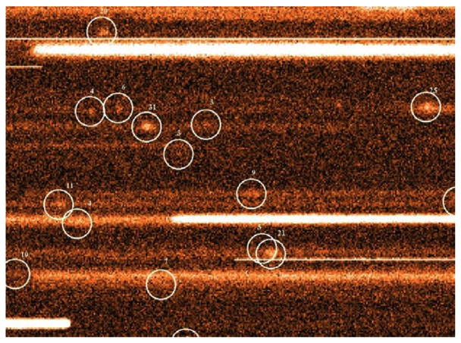
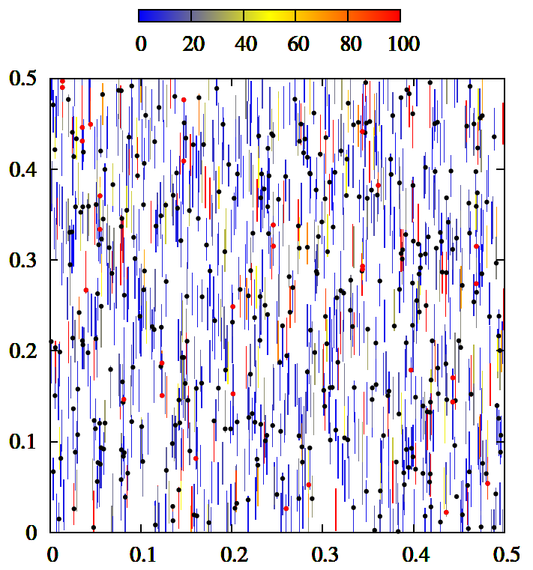
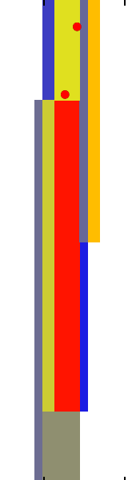
Slitless Spectroscopy: purity
Impact of incorrect line identification on cosmological parameters
Effect measured through large mock-samples (simulations)
Contaminated Hα lines
de la Torre, Zoubian, Markovic et al.

Slide 18
Minimising Astrophysical Biases
Biases can be minimised by:
restricting the observation space that is used, for example
  limiting range of angular frequencies on sky
  avoiding regions affected by extinction or too high stellar density,
...but these themselves introduce other biases to be considered;
modelling, using (astro)physical or machine-trained models
  tantamount to including “prior” information
...but these themselves introduce other biases to be considered;
application of corrections identified from calibrations;
application of corrections identified from simulations;
or, combinations of the above.

Slide 19
Corrections from Calibrations
Calibrations are required for instrumental effects (bias, PSF, flat field etc.): in all cases these should be taken from the data themselves rather than separate observations – which,
because of the transfer to the data will always be wrong at some level
Calibrations for astrophysical effects should also be taken from within the data where possible: examples
  intrinsic alignments (using morphology within field + photo-z)
  noise bias (using Deep Field)
but these will generally require simulations also
Most astrophysical calibrations will require additional or external observations: examples
  colour gradients within galaxies (HST calibration sample)
  background subtraction (HST, or Deep Field)
  photo-z calibrations through deep spectroscopy
and these will generally require simulations also.

Slide 20
Prospects
Baryon physics generally takes place on smaller scales
  feedback
  environmental effects
Access to smaller angular scales via a greater understanding of the baryon physics (normal astrophysics; galaxy evolution…)
Once these processes are understood, greater accuracy is potentially available
  but if they are incompletely understood, then they introduce biases and hence incorrect cosmology
  Corrections at catalog level or through simultaneous modelling
  example: consider simultaneous fitting to cluster mass concentrations via strong and weak lensing, solving at the same time for intrinsic alignments

Slide 21
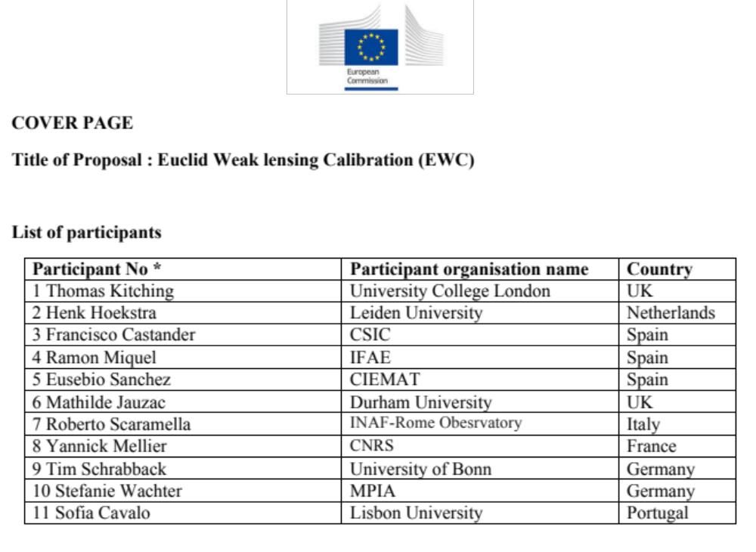
Astrophysics & Cosmology
In Weak Lensing, European proposal to further understand the astrophysical effects in cosmology

Slide 22
Conclusions
Massive surveys and powerful instrumentation will give Euclid sufficient precision to make significant cosmological advances…
if the instrumental and astrophysical biases can be controlled
Instrumental biases can in principle be nulled out
Astrophysical biases require a mixture of simulations and internal & external calibrations for their quantification
Many astrophysical biases require an understanding of the baryonic processes which are the realm of galaxy evolution and fundamental astrophysics (eg the effects of environment and feedback)
⇒ it is essential to include these effects, especially at smaller angular scales to recover correct cosmology
Significant opportunities for progress lie at this interface.

